Slide 1
Hackathon Decode 11.3 SLACK QUERY DATASET ANALYSIS Using Tableau
BY –Akhilesh Mishra
DS20DEC03

Slide 2
Description
The data represents Slack Queries of an Ed Tech Company and their resolution status.

Slide 3
Features
Ticket Id – Unique ticket id for each query raised.
Student or WP- Categories of person asking query (Student, Working Professional).
Program Name- Program Name ('Full stack Program', 'Backend Program', 'Fellowship Program').
Status (Ticket)- Status of Ticket.
Created Time (Ticket)- Time when ticket was created.
Ticket Closed Time- Time when query was resolved.
First Response Time- Time when first responded.
Project Phase- Project phase ('trial phase', 'fullstack-phase-1', 'fullstack-phase-2', 'system-issues', 'backend-phase2', 'fullstack-phase-4', 'fullstack-phase-3', 'fellowship-phase-1', 'backend-phase-3', 'backend-phase1')

Slide 4
Problem statement
1. Check the Datatypes and convert relevant columns to Date and Time format.
2. Fill Missing Values with Appropriate Method.
3. Check how many Students and Work Professionals are raising queries, who’s queries are more.
4. What is the Average time taken to respond to a query?
5. List down top 10 queries that took longest time to resolve.
6. Which Phase of Project is having highest Queries?
7. Which project phase queries are taking a long time to resolve?
8. On which day highest queries were resolved?
9. Which phase queries are easier to resolve?
10. Provide Conclusion for your analysis.

Slide 5
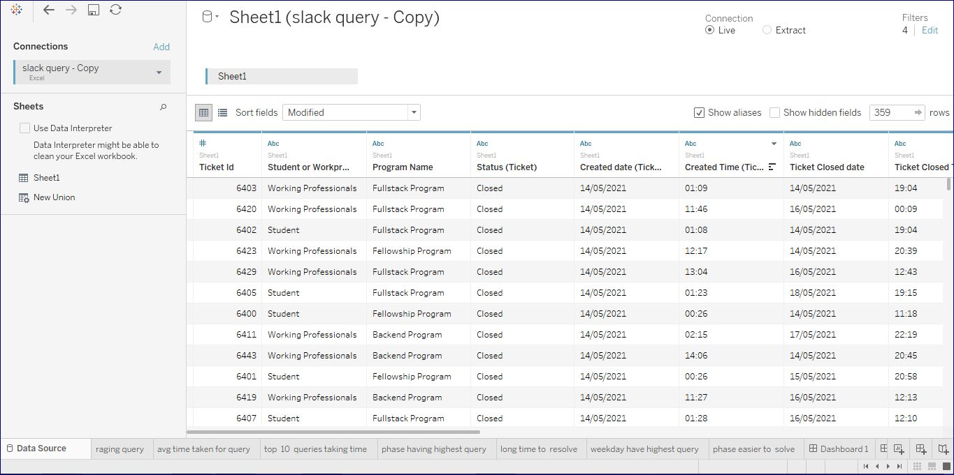
Answer 1

Slide 6
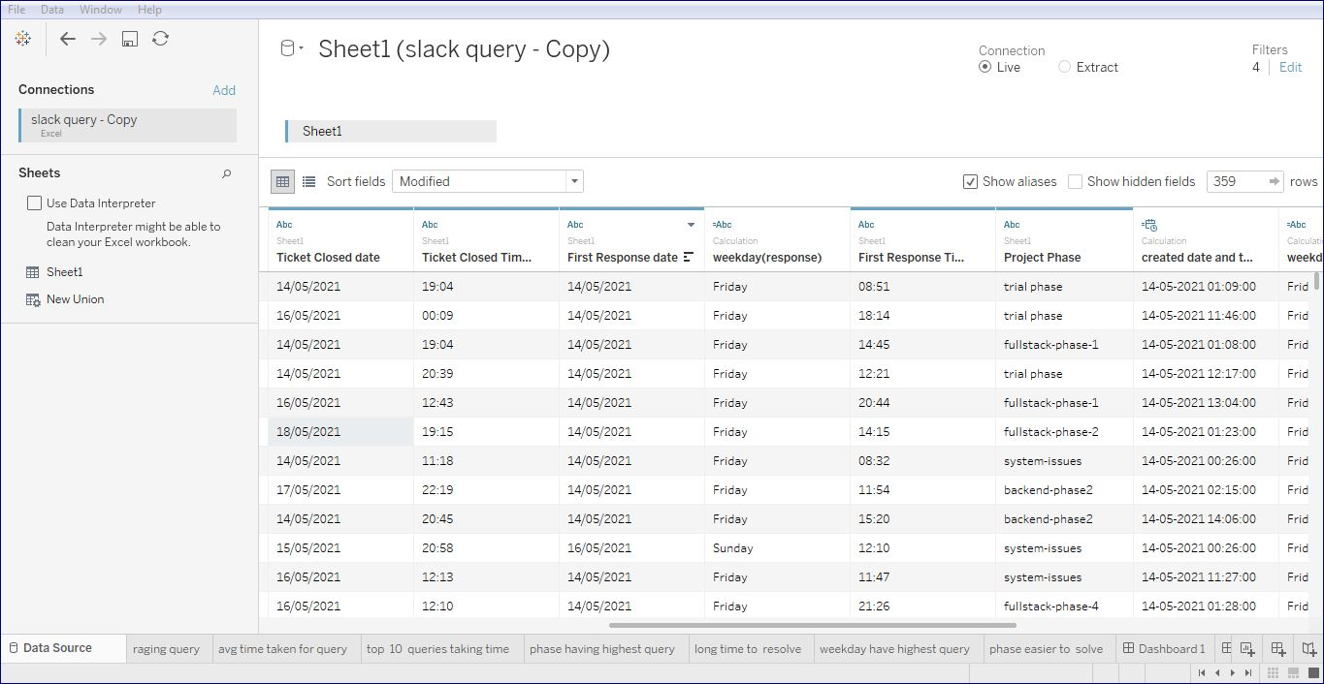

Slide 7
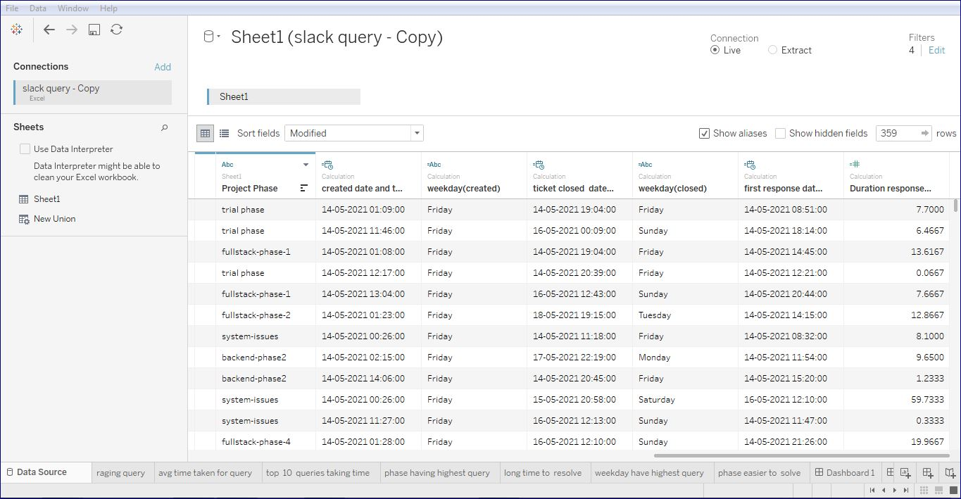

Slide 8
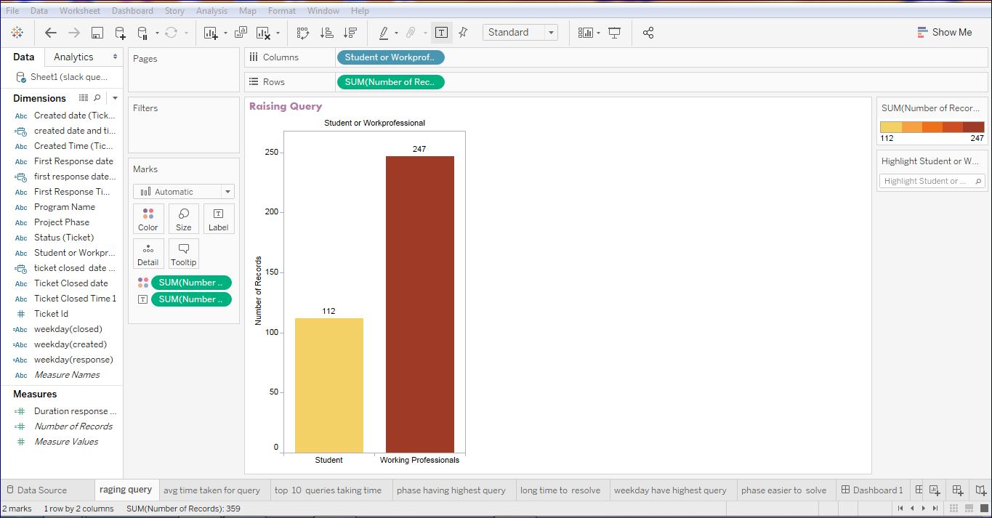

Slide 9
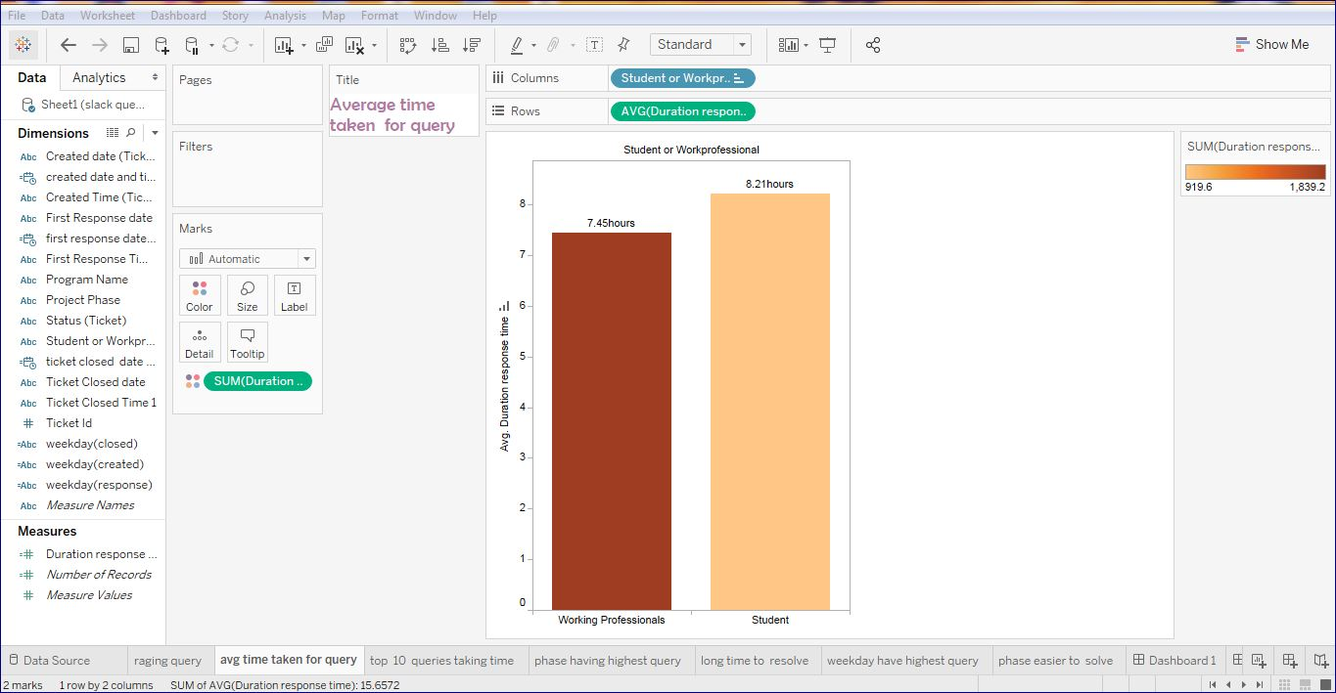

Slide 10
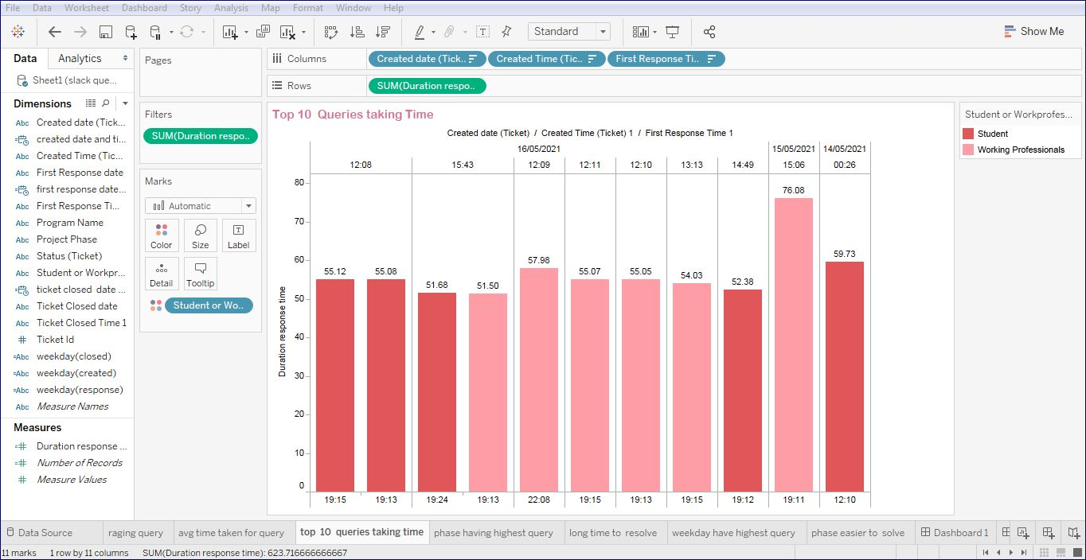

Slide 11
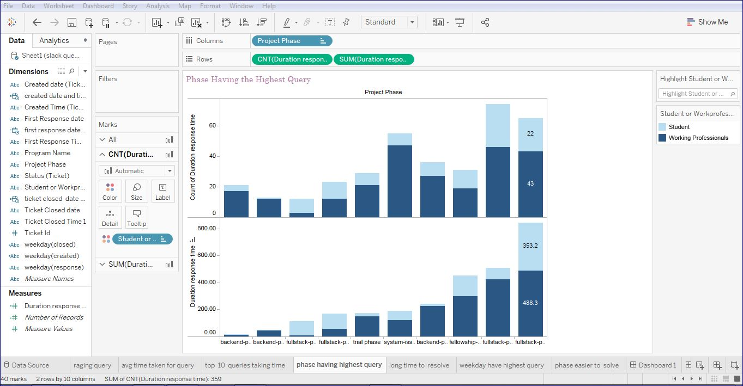

Slide 13
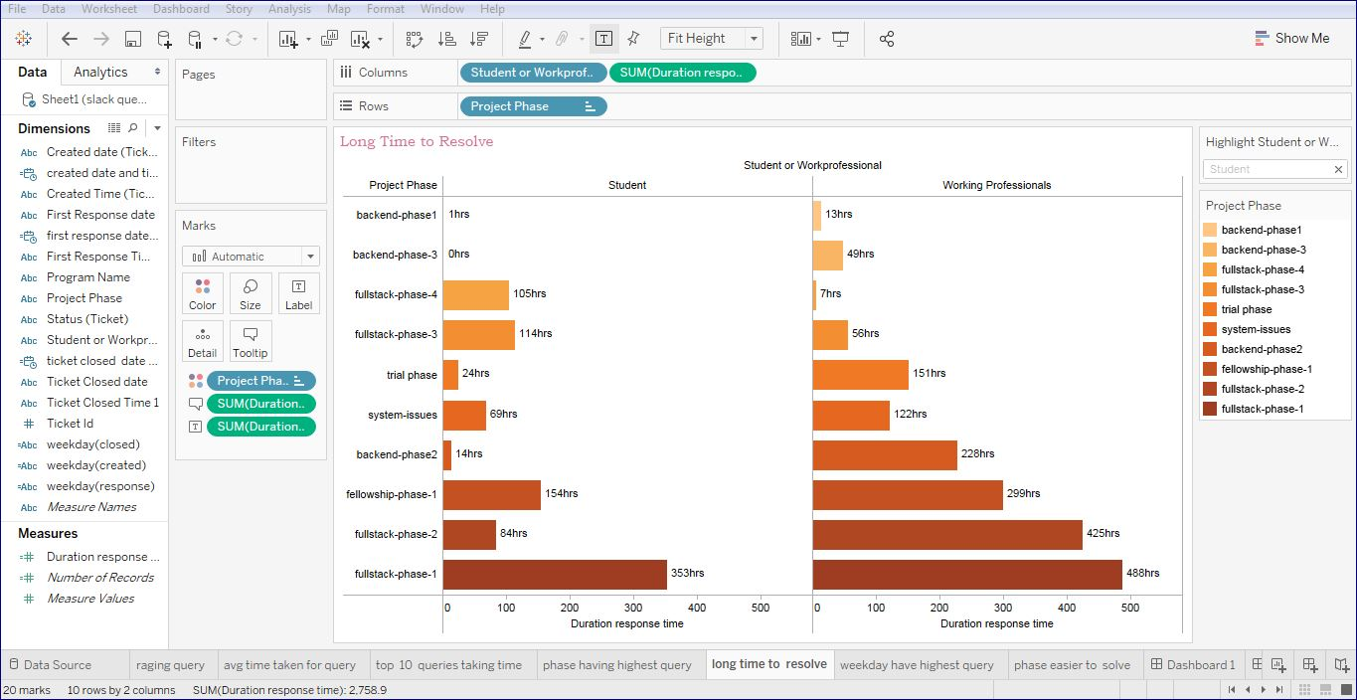

Slide 14
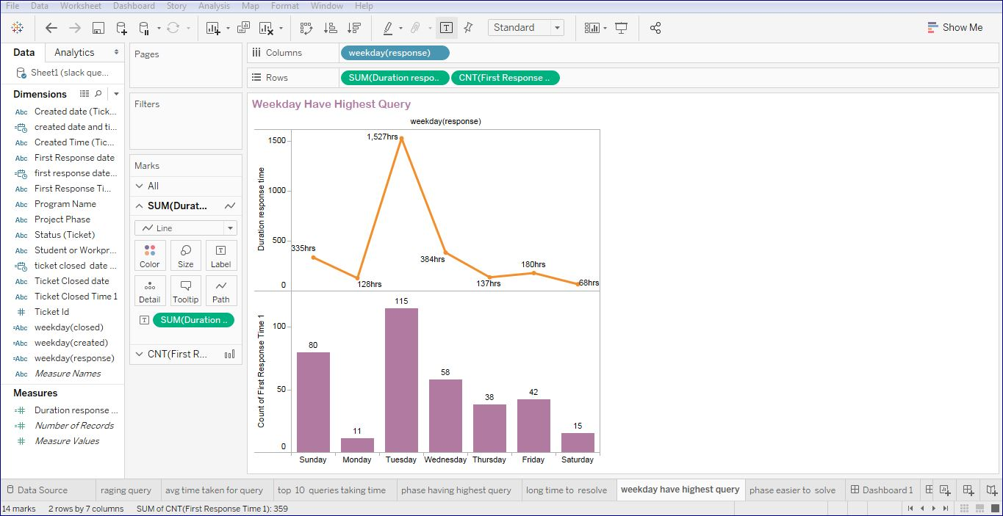

Slide 15
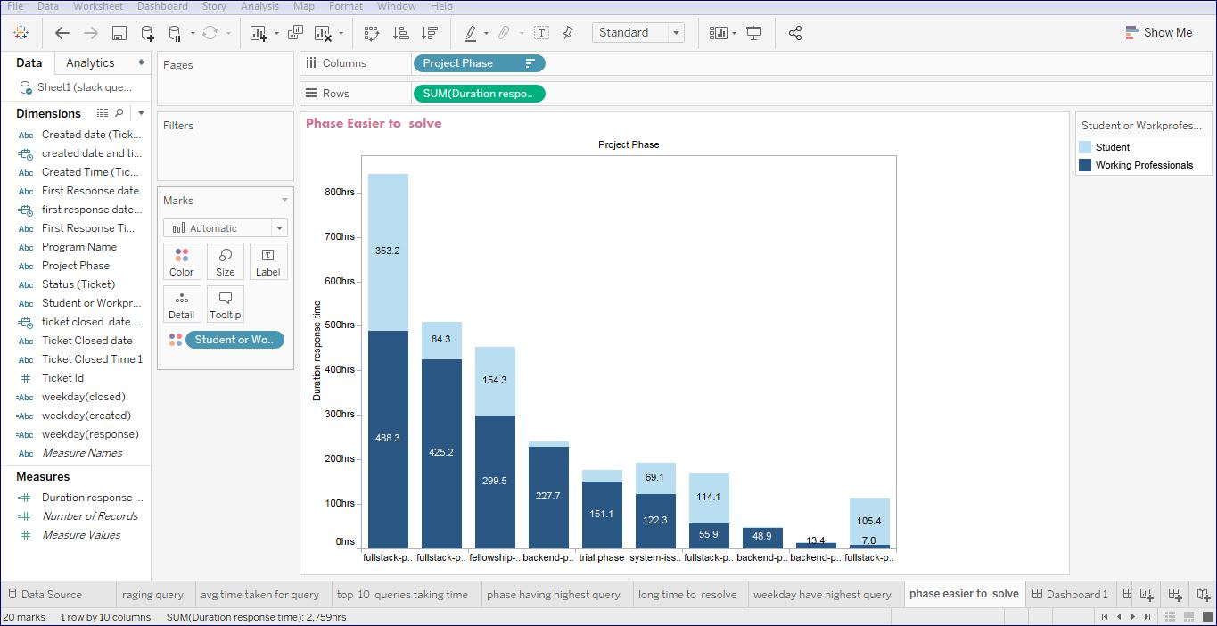

Slide 16
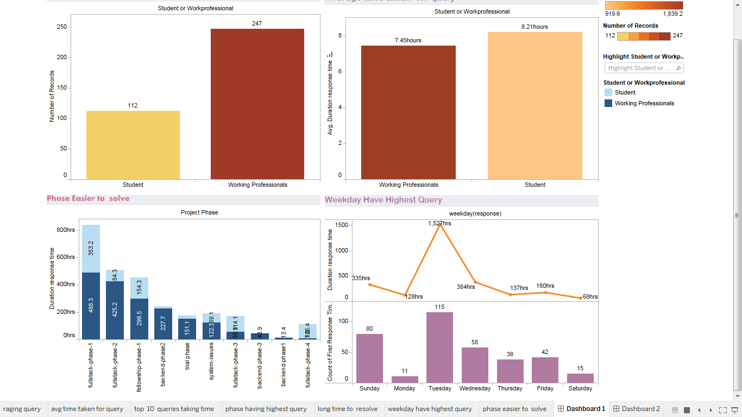

Slide 17
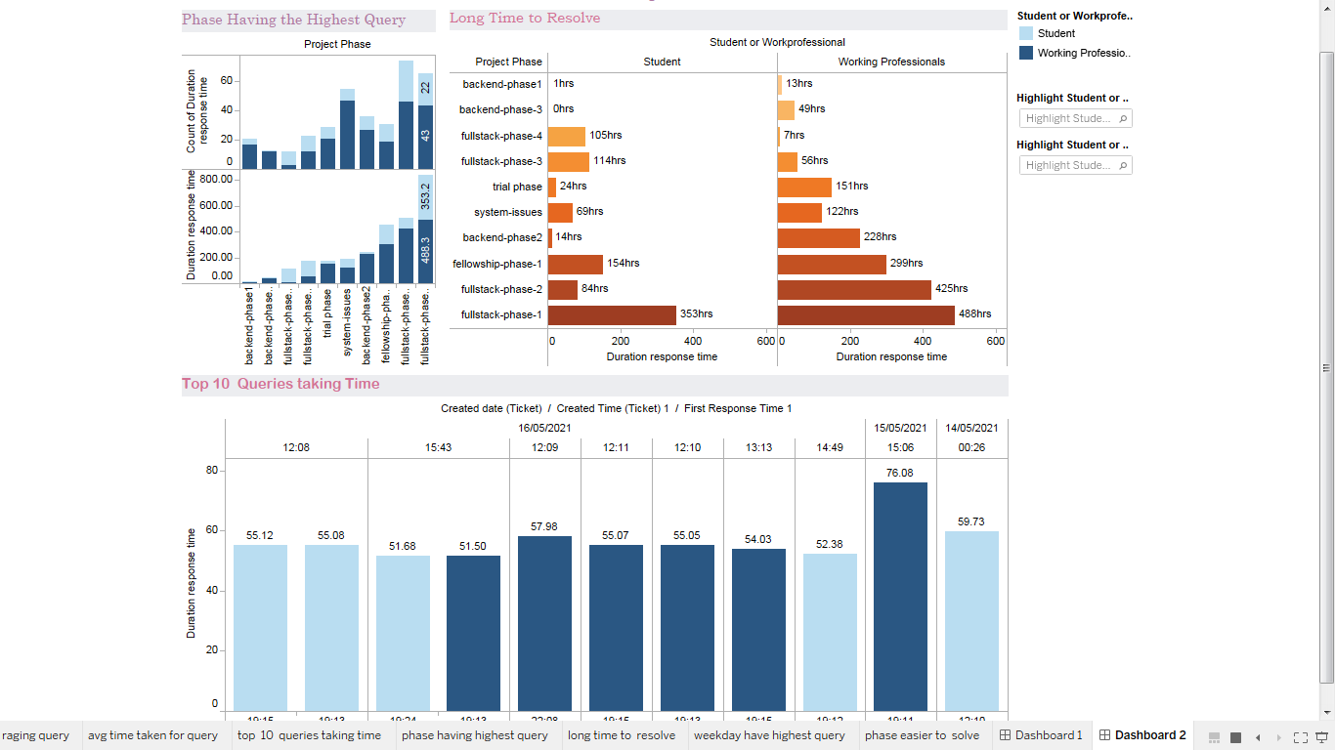

Slide 18
Thank you

